Slide 1
Computer ARCHITECTURE (CA)
Course Instructor
Hira beenish
Department of Computer Science

Slide 2
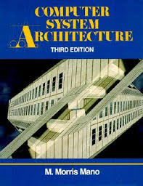
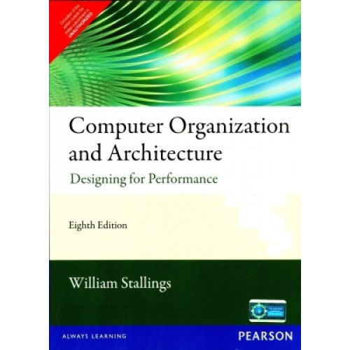
Recommended Books
Computer Systems Architecture, 3rd Edition
By M.Morris Mano; Prentice Hall International
Computer Organization and Architecture Designing For Performance By William Stallings

Slide 3
Chapters Included
1. Digital logic circuits
2. Digital components
3. Data Representation
4. Basic Computer Organization & Design →→Mid Term
5. Central processing unit
6.Pilpeline & vector processing
7. Computer arithmetic
8. I/O & O/P organization
9. Memory organization
10. Multiprocessors

Slide 4
Chapter#4 Central processing unit

Slide 5
Contents
Introduction
General Register Organization
Stack Organization
Instruction Formats
Addressing Modes
Data Transfer and Manipulation
Program Control
Reduced Instruction Set Computer (RISC)

Slide 6
MAJOR COMPONENTS OF CPU
Storage Components:
Registers
Flip-flops
Execution (Processing) Components:
Arithmetic Logic Unit (ALU):
Arithmetic calculations, Logical computations
Transfer Components:
Bus
Control Components:
Control Unit

Slide 7
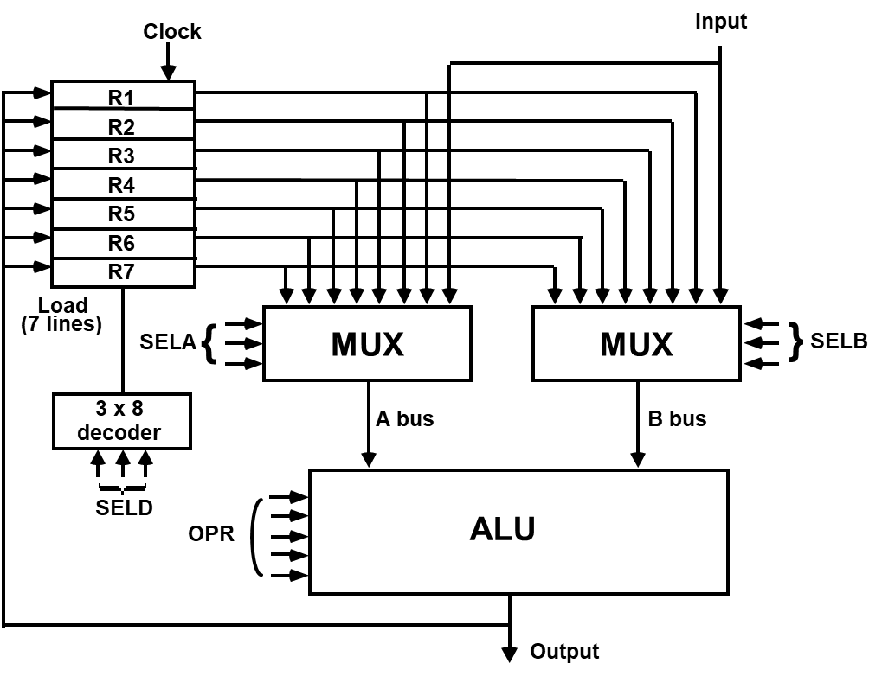
GENERAL REGISTER ORGANIZATION

Slide 8
Stack or LIFO(Last-In, First-Out)
A stack is a specialized buffer which stores data from the top down.
Stack is a storage device that stores information in such a manner that the item stored last is the first item retrieved.
Stack pointer
The register that holds the address for the stack is called Stack pointer
stack pointer is a small register that stores the address of the last program request in a stack.
Two Operations of a stack : Insertion and Deletion of Items
PUSH : Push-Down = Insertion
POP : Pop-Up = Deletion

Slide 9
MEMORY STACK ORGANIZATION
A portion of memory is used as a stack with a processor register as a stack pointer
- PUSH: SP ← SP - 1
M[SP] ← DR
- POP: DR ← M[SP]
SP ← SP + 1
most computers do not provide hardware to check
stack overflow (full stack) or underflow(empty stack)
: Increment SP
: Write to the stack
: Check if stack is full
: Mark not empty

Slide 10
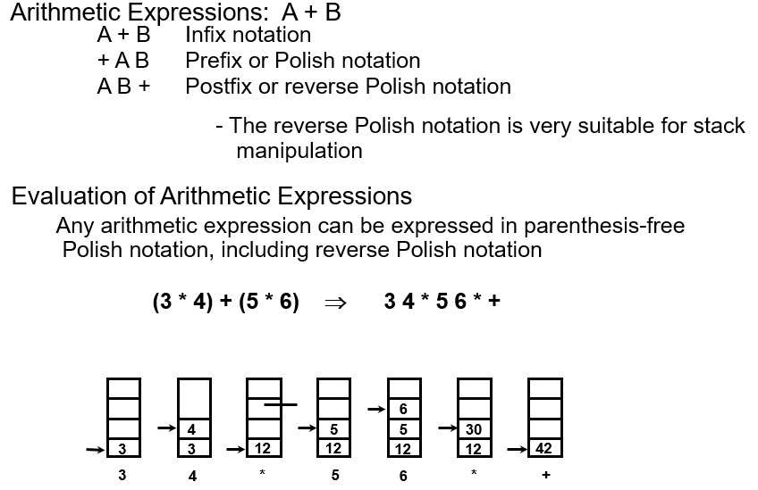
REVERSE POLISH NOTATION

Slide 11
PROCESSOR ORGANIZATION
in general, most processors are organized in one of 3 ways
Single register (Accumulator) organization
basic computer is a good example
accumulator is the only general purpose register
General register organization
used by most modern computer processors
any of the registers can be used as the source or destination for computer operations
Stack organization
all operations are done using the hardware stack
for example, an or instruction will pop the two top elements from the stack, do a logical or on them, and push the result on the stack

